Slide 1

A Sustainable Planet:
The food crisis – why plant-soil interactions matter
Professor Sophie Nixon
Department of Earth and Environmental Sciences
sophie.nixon@manchester.ac.uk;
MIB

Slide 2
Focal areas of this lecture:
Background context to the SDG ‘Zero Hunger’
What are the major agriculturally-driven sustainability issues?
What are the underpinning mechanisms that lead to soil degradation?
What can be done to mitigate them?
How do plants get resources?
Partnerships: ‘mutualistic’ relationships between plants and other organisms (bacteria and fungi)

Slide 3
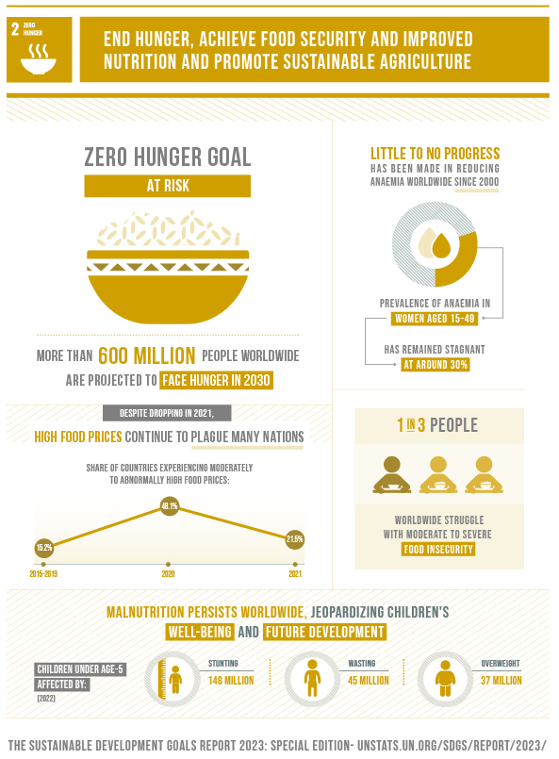
Key environmental science related challenges:
More food needed, using fewer resources
Reduce environmental impact of growing and distributing this food
Identify new ways to grow food, extract plant-growth limiting resources
Ensure farming systems are resilient to perturbations and pests
2024 status: Regression

Slide 4

today’s population:
8.2 billion
•

Slide 5
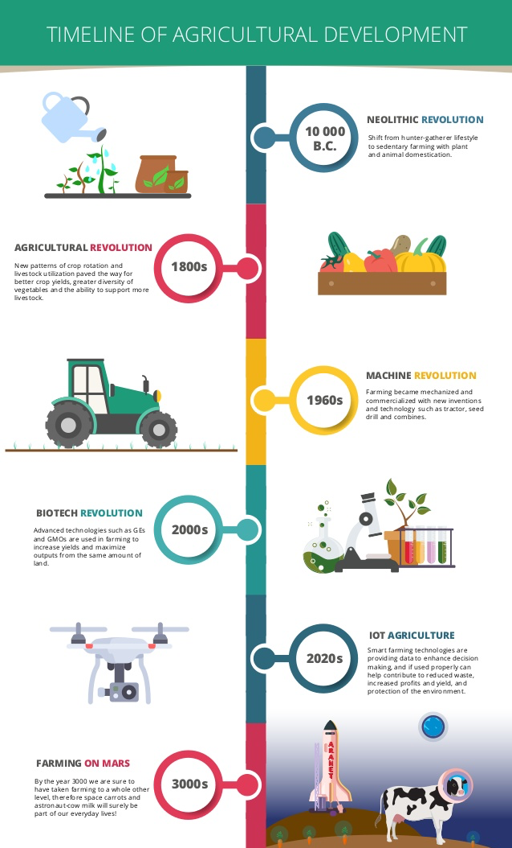
The agri revolution
(…and a hint at the future?)
Some key events:
Domestication of livestock and crops
Labour availability
Landscape modification
Rotations
Efficient tools
Policy incentives
Mechanisation
Crop breeding
Artificial inputs (fertilisers, pesticides)

Slide 6
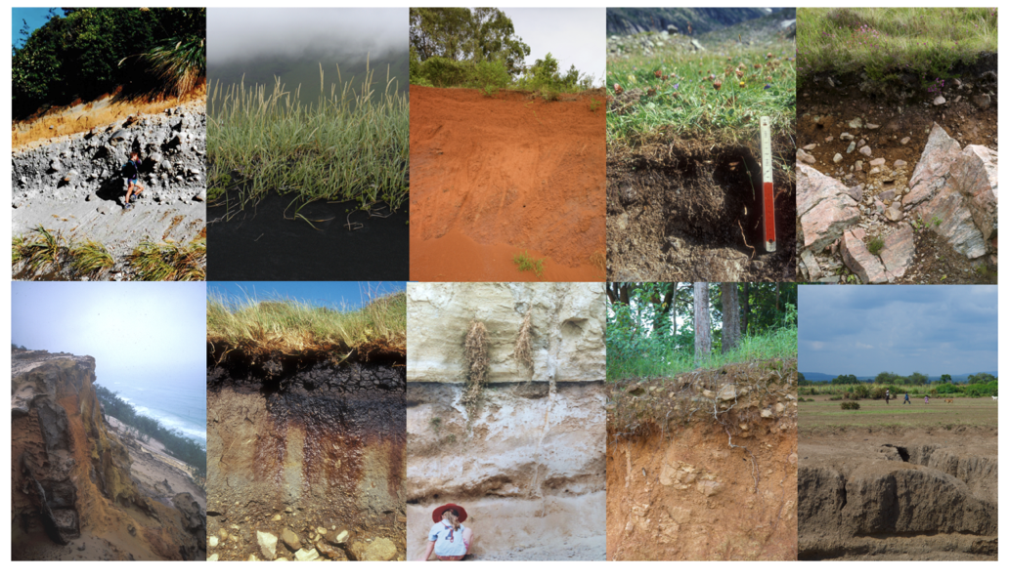
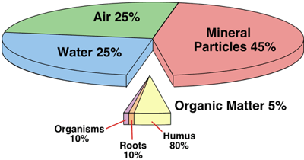

Soil – the foundation of life on Earth
Soils are alive! They contain myriad organisms across all kingdoms of life
Soil also contains water, gases, organic matter, and minerals; they are chemically, physically and biologically diverse
These properties mean soils can be grouped into a classification system
Soil organic matter is made up of thousands of different forms of carbon and other critical elements and is key to carbon storage

Slide 7
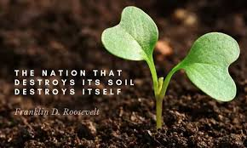
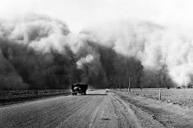

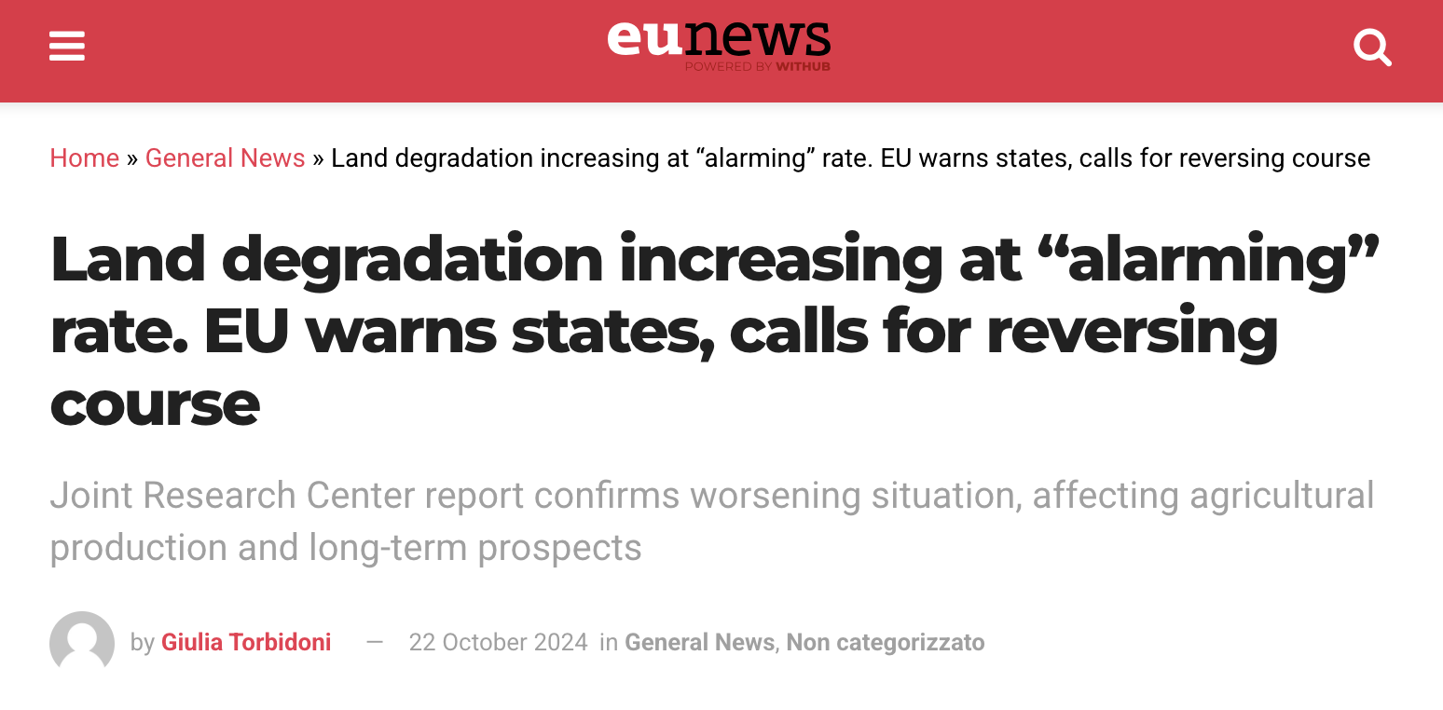
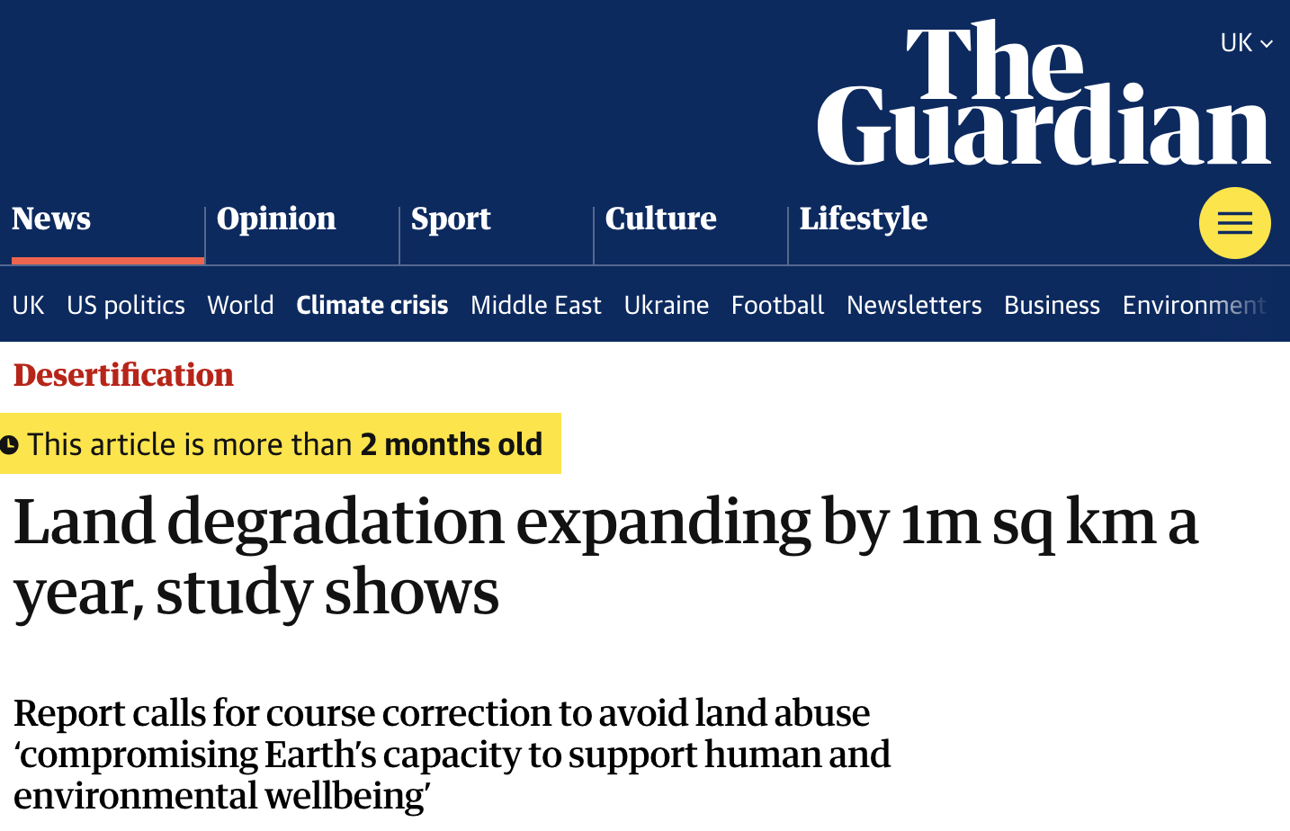

Soil: treat it badly and humans can die!
The Dust Bowl (1930s USA)
Notes:
The Dust Bowl (1930s USA):
Caused by intensive ploughing, monoculture farming, and removal of deep-rooted native grasses in the Great Plains led to severe soil erosion
Resulted in dust storms (“black blizzards”), displacement of 2.5 million people, mass starvation and economic collapse
Jared Diamond’s Collapse argues that environmental degradation, particularly soil erosion and depletion, has been a key factor in the downfall of civilizations

Slide 8
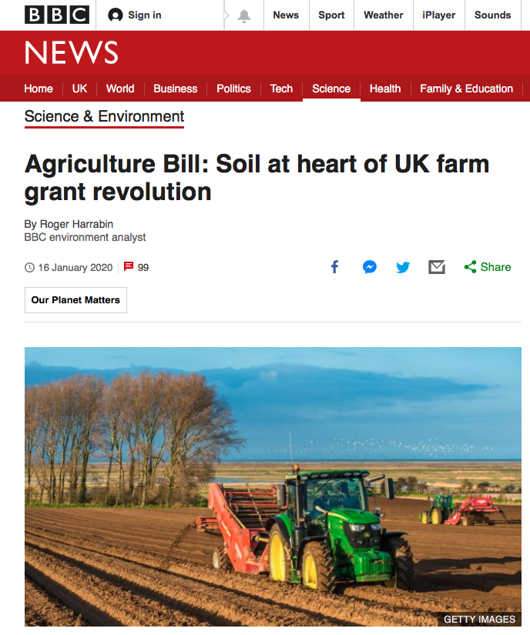
In the UK, the way we incentivise farmers has changed under Brexit
The idea is that farming practices enhance ecosystem services e.g. farmers incentivised to enhance soil carbon stocks, improve air and water quality, reduce flooding and GHGs
How this will happen (and how well we are doing since 2020) is still unclear!

Slide 9

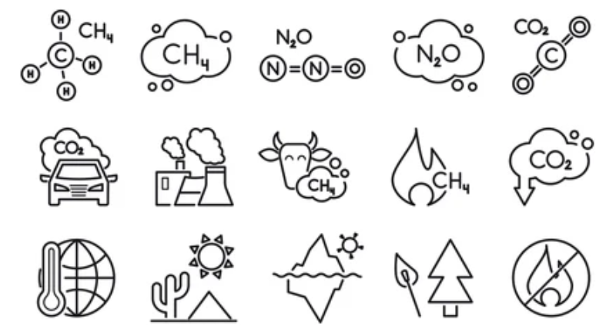
Two example issues that need to be tackled….
Soil Degradation
Greenhouse gas emissions

Slide 10
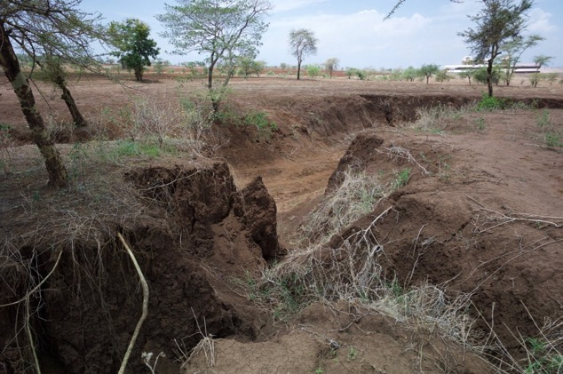
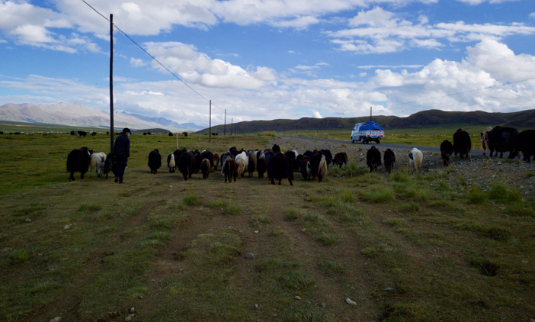
Issue 1:
Soil degradation
What is ‘soil degradation’?
Soils are complex and can be degraded in many ways! Degradation depends a bit on your perspective, but most farmers would consider it being:
“a reduction in the ability of soil to produce crops or support livestock”

Slide 11
Degradation:
Change (usually for the worse) in key soil properties
Grazing and harvesting plants removes essential elements acquired by plants from soil. e.g. nitrogen, potassium and phosphorus. How do these nutrients get replaced?
Biomass is also often removed. Biomass = organic matter and confers many benefits (water holding capacity, biological activity, nutrients, etc)
Working the land with machines (tillage) affects ‘physical’ properties of soils
Erosion: complete loss of soil!

Slide 12
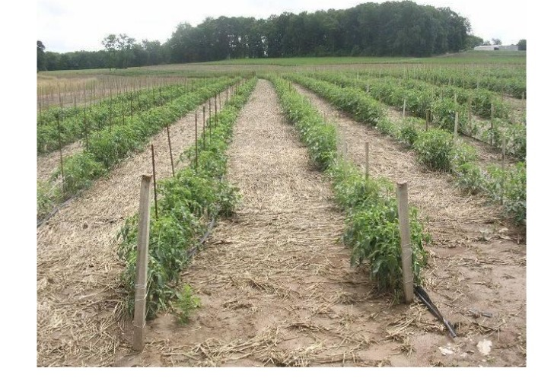
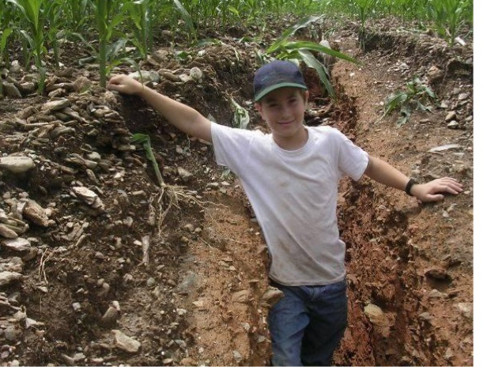
USA: different tillage (i.e. land management) practices can have dramatic effects on the ability of soil to erode
Tomatoes grown using a so-called ‘no-till’ farming system
Compared to ‘conventional till’ farming system; i.e. use of ploughs, harrows etc

Slide 13
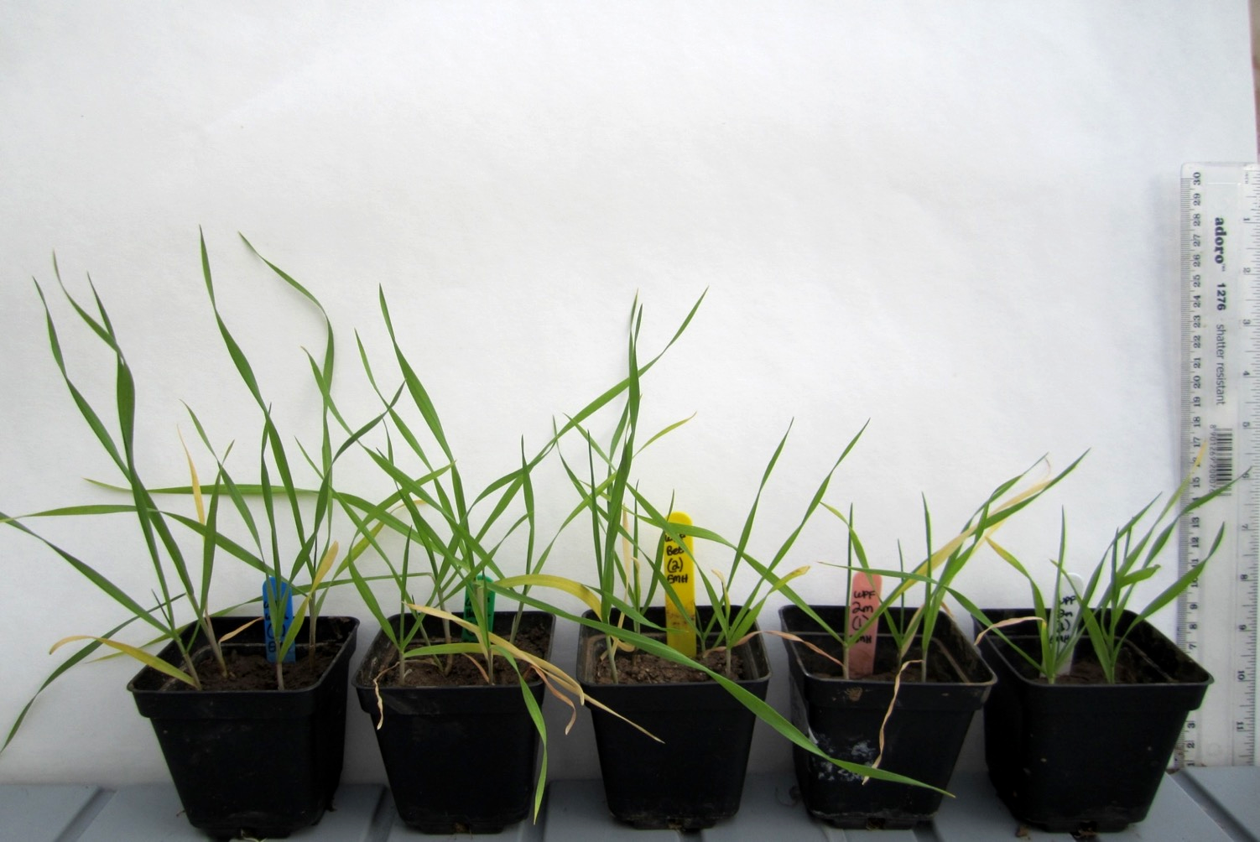
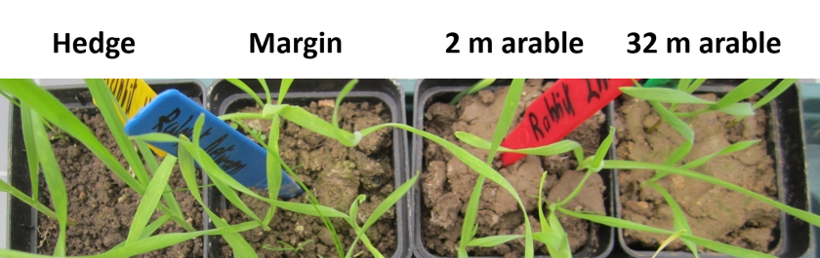
Soil quality declines into arable fields
wheat grown without added fertilizer for 6 weeks in a standard weight of soil
https://doi.org/10.1016/j.agee.2018.11.027
37% decrease in organic C
22% increase in bulk density
2 m
arable
32 m
arable
Wood
Hedge
Grassy
strip
(E. Marshall-Harris, J.R. Leake)

Slide 14
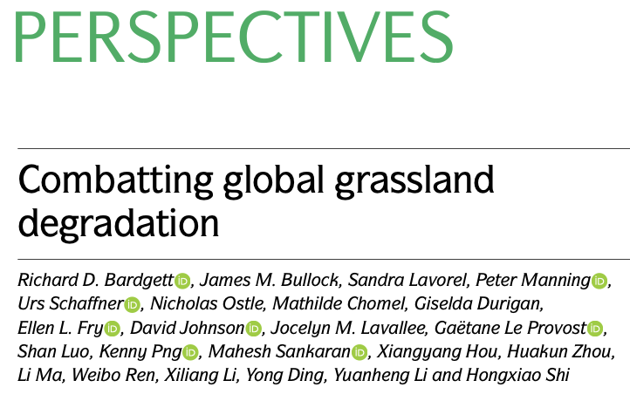
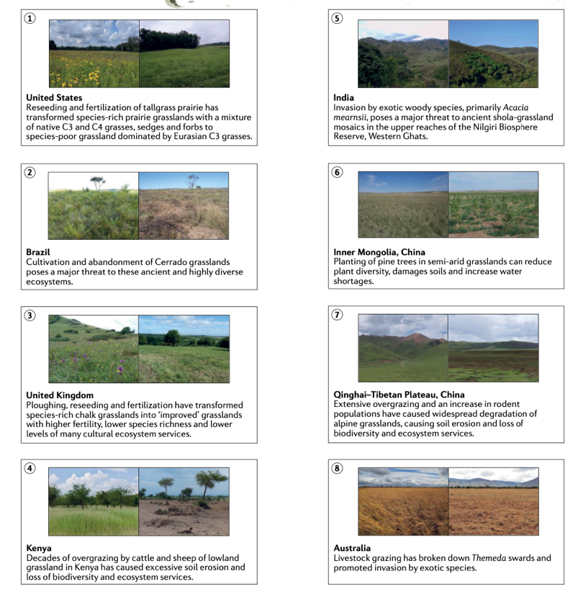
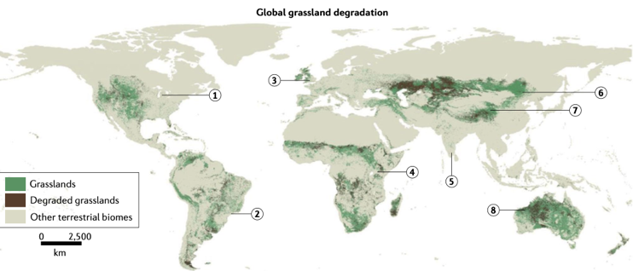
A perspective on grassland degradation
.. https://doi.org/10.1038/s43017-021-00207-2.

Slide 15
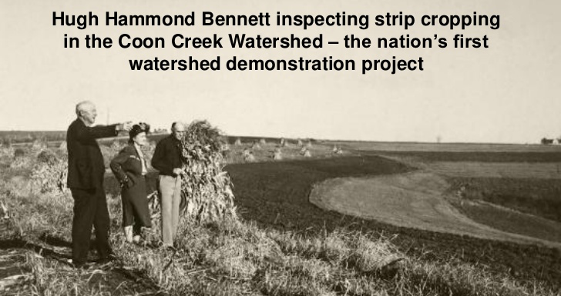
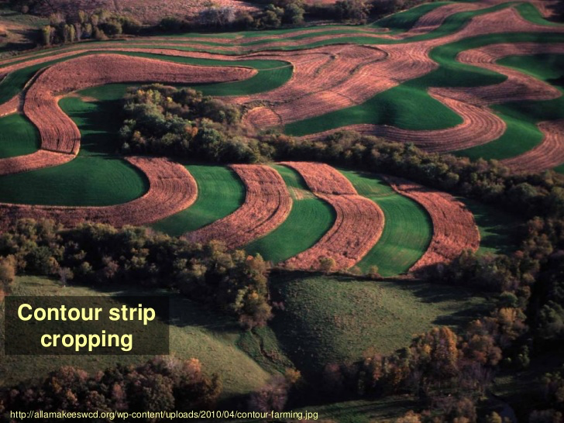
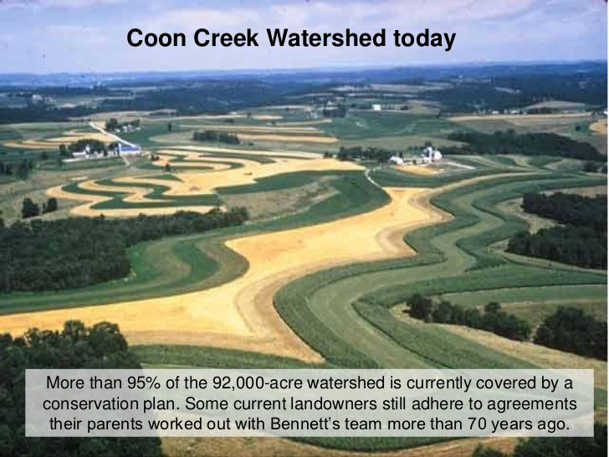
Solutions!

Slide 16
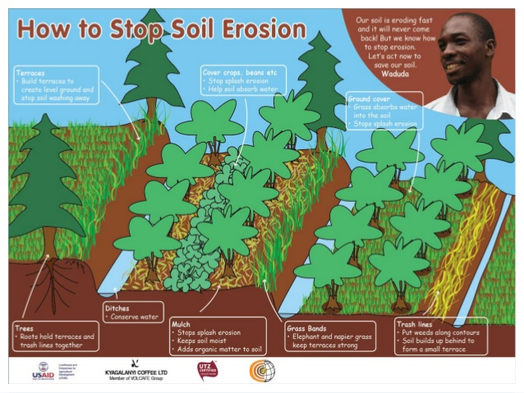

Slide 17
Issue 2:
Greenhouse gas emissions (CH₄, CO₂, N₂O)
Globally, agriculture contributes 25% of all greenhouse gas emissions from human activity
Emissions occur at various stages of production (direct loss from animals; soils; storage of effluent; transport etc)
There is huge variability in emissions depending on the agricultural practice and location
Soil management is key: some greenhouse gases are mainly soil derived (e.g. N₂O, nitrous oxide)

Slide 18
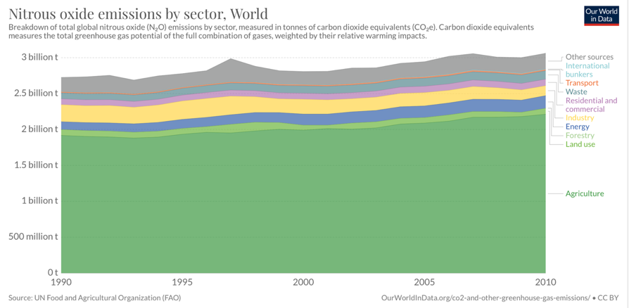
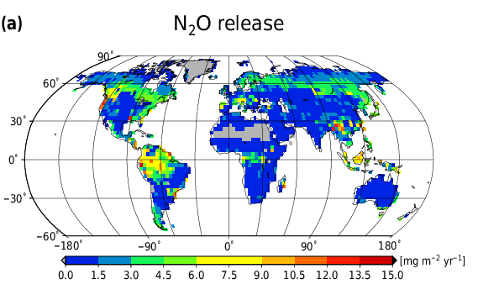
Global patterns of N₂O emissions
Notes:
mg m⁻² yr⁻¹ N₂O release

Slide 19
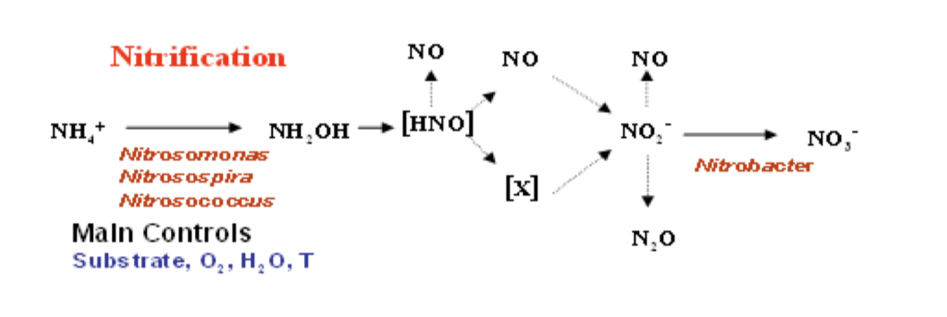
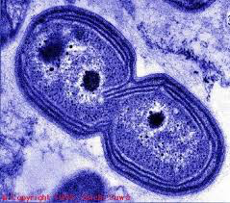
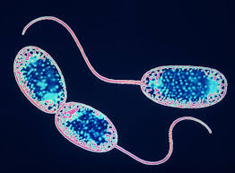
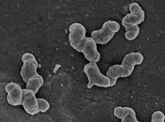
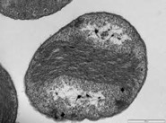
Nitrogen cycling is an important aspect of soil biology

Slide 20
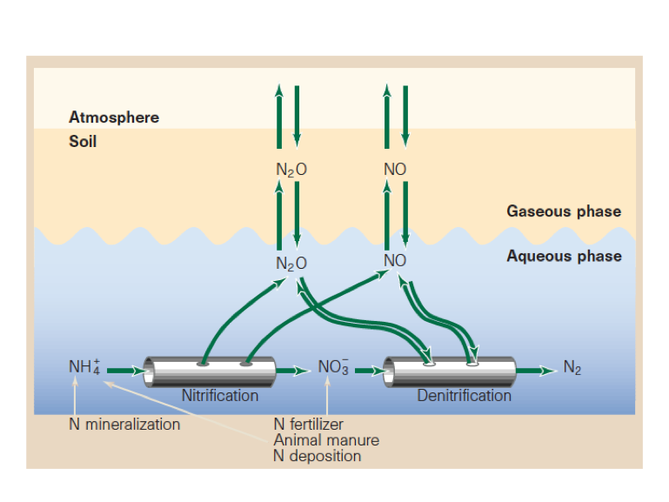
‘Hole in the pipe’ model of nitrous oxide (N₂O) production and consumption

Slide 21
Nitrate reduction: Denitrification
Anaerobic/near-anaerobic processes
Large diversity of microorganisms capable of denitrification – many bacteria
High energy yields; efficient metabolism
Principal mechanism by which N is returned to the atmosphere

Slide 22
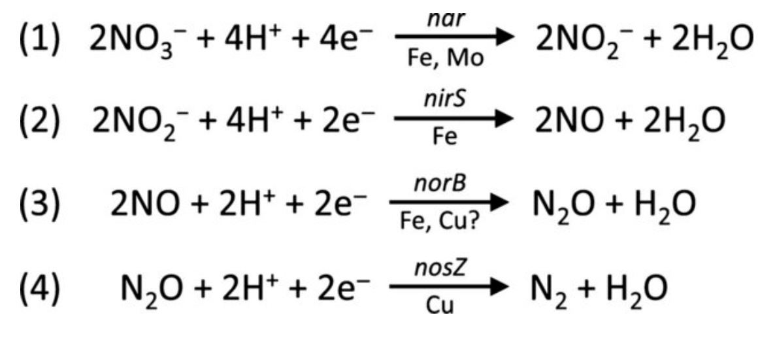
Multi-step process, releasing N₂O and N₂:
Nitrate
Nitrite
Nitric oxide
Nitrous oxide
Nitrogen gas and water
(harmless)
(a GHG)
nar : nitrate reductase gene
nirS : nitrite reductase gene
norB : nitric oxide reductase gene
nosZ : nitrous oxide reductase gene

Slide 23
Nitrate reduction: Denitrification
Key environmental controls:
Temperature
Soil moisture
Soil redox – denitrification is anaerobic
Substrate availability – low C or NO₃– availability suppresses denitrification; high labile C favours N₂O production (not N₂)
pH – low pH suppresses denitrification enzyme activity and also inhibits complete denitrification to N₂ (more N₂O)

Slide 24
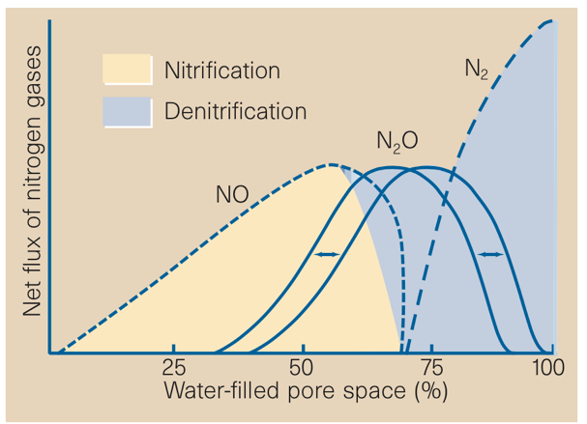
Effects of soil moisture on nitrification, denitrification and N-gas flux

Slide 25
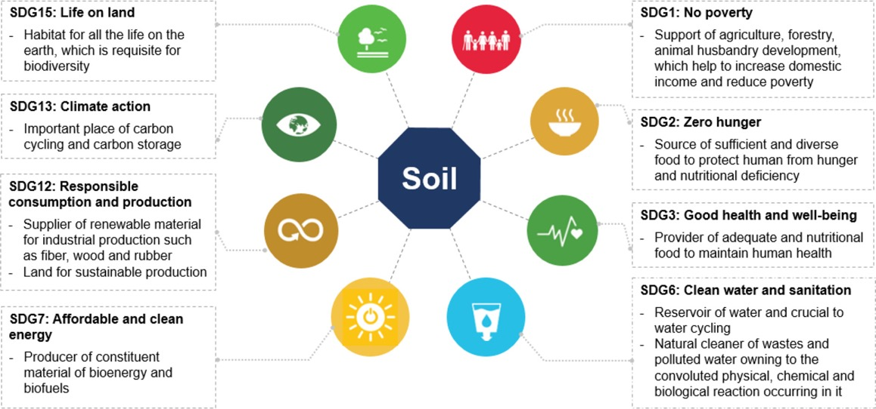
Understanding how plants respond to nutrients, and how they acquire nutrients, will enable us to devise sustainable crop and forestry management strategies
The next part of the lecture looks at nutrient and fertiliser use and ‘natural’ nutrient cycling processes

Slide 26
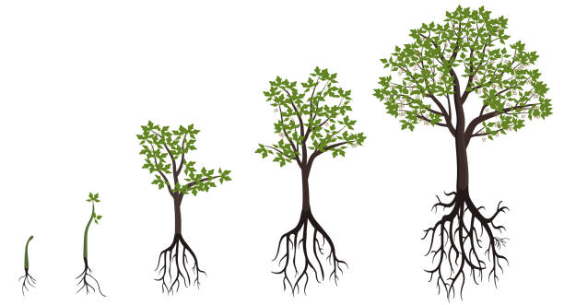
Plants need mineral nutrients from soil –
The ‘big 3’: nitrogen (N), phosphorus (P), potassium (K)
+ other ‘trace’ elements like boron, iron, selenium
Most fertilisers are ‘NPK’ in varying proportions

Slide 27
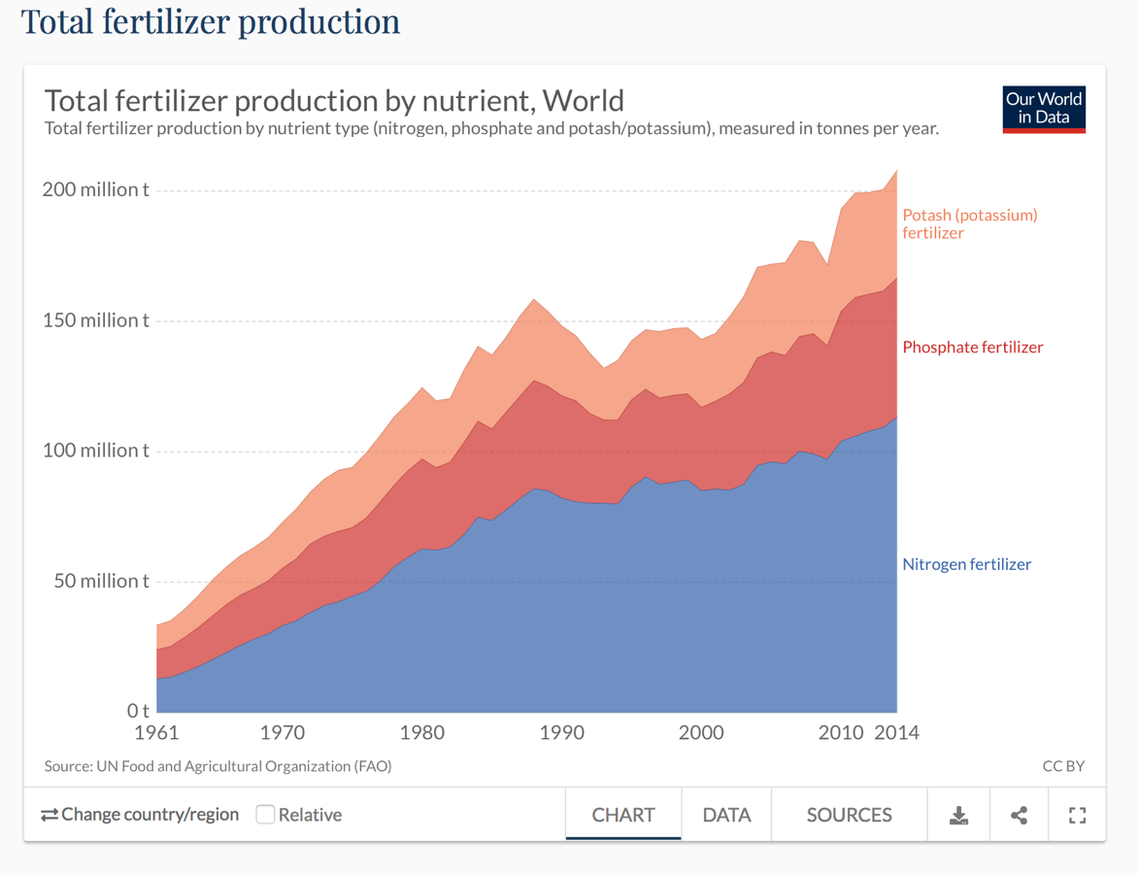
Humans have ‘short-circuited’ nature’s nutrient cycles by synthesising fertilisers

Slide 28
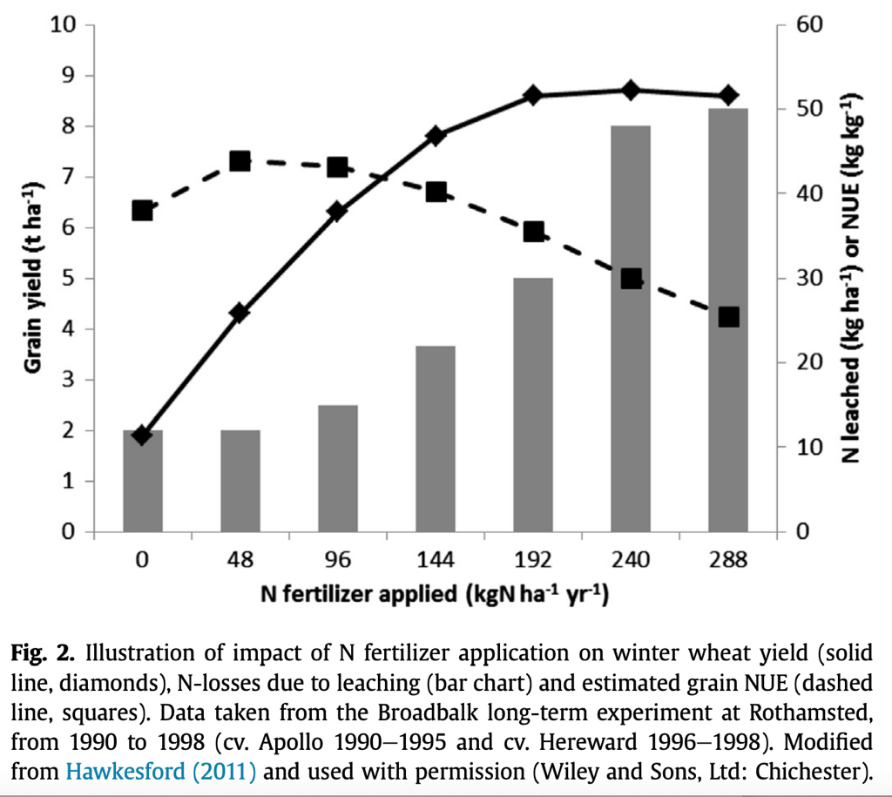
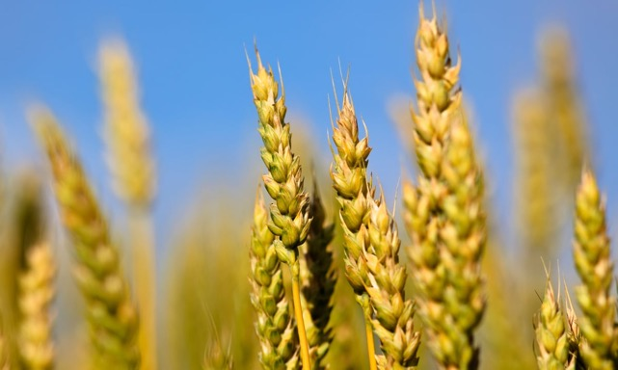
An example:
Wheat yield (solid line) does not respond linearly to N fertilizer addition.
Nitrogen Use Efficiency (dashed line) decreases
Journal of Cereal Science 59 (2014) 276e283

Slide 29
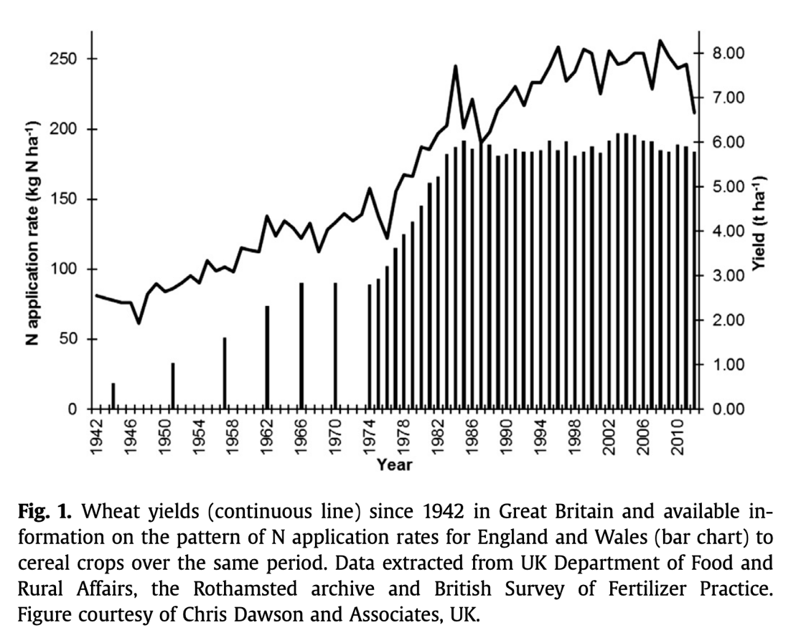
Yields of wheat have increased over the last 100 years
Journal of Cereal Science 59 (2014) 276e283

Slide 30
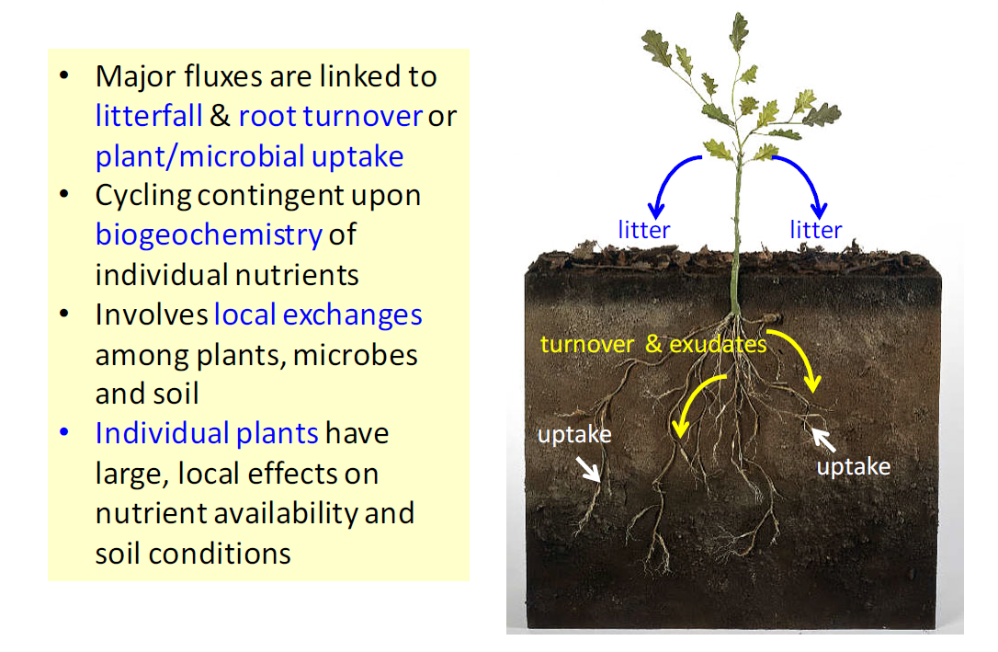
Understanding how plants have evolved to acquire nutrients may help develop sustainable strategies to increase yield
Nutrient Cycling

Slide 31
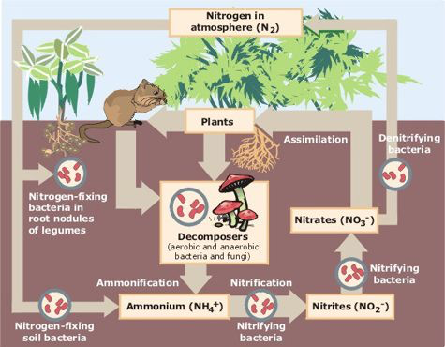
As we have seen, nitrogen (N) often limits plant growth.
Let’s look at the terrestrial nitrogen cycle
The size of the pools and the rate at which pools are transformed varies according to context
In many soils, the organic N pool is large

Slide 32
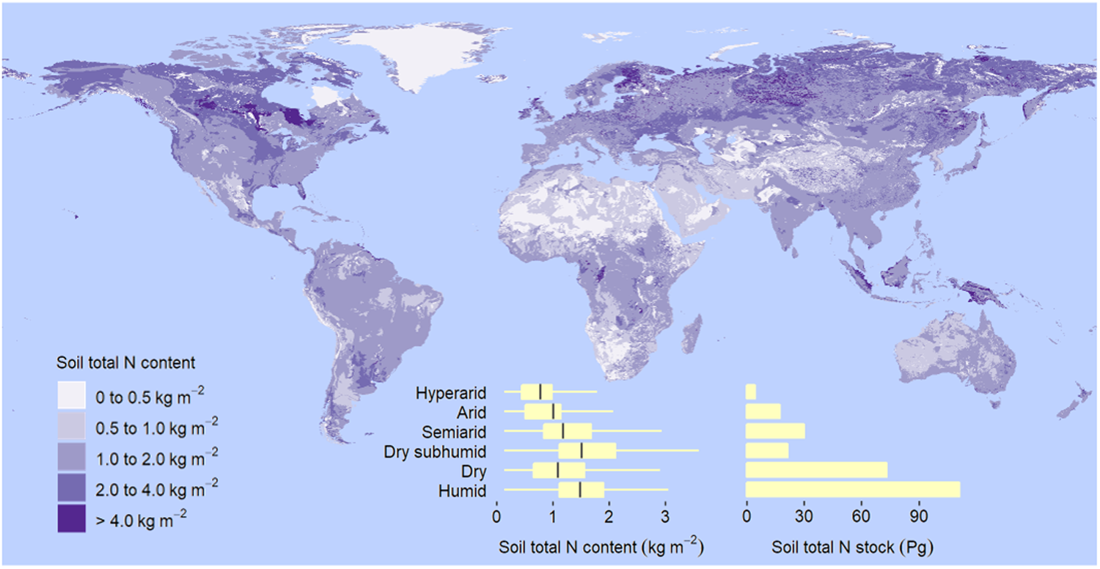
The distribution of nitrogen in soil is heterogeneous across large and small scales
César Plaza, Claudio Zaccone, Kasia Sawicka, Ana M. Méndez, Ana Tarquis, Gabriel Gascó, Gerard B. M. Heuvelink, Edward A. G. Schuur & Fernando T. Maestre “Soil resources and element stocks in drylands to face global issues” Scientific Reports 8: 13788 (2018)

Slide 33
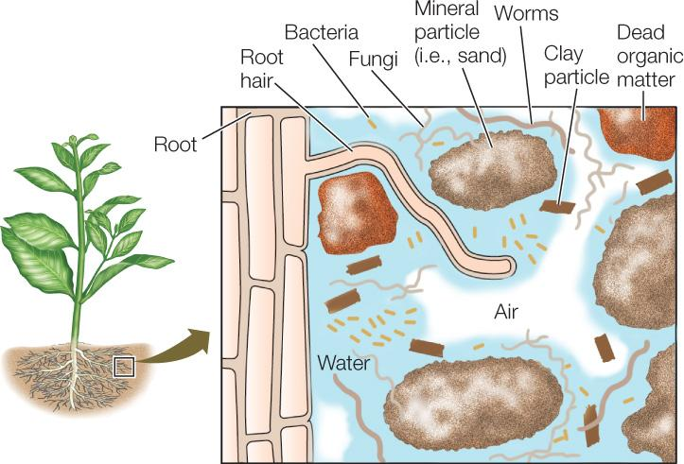
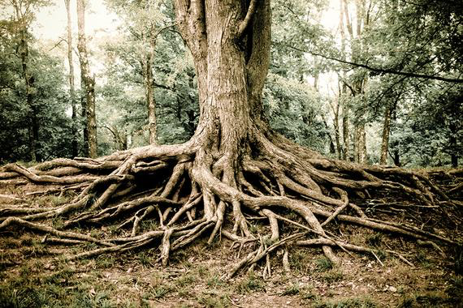
Plants acquire nutrients from soil to grow….
…using only their roots, right?
WRONG!
Most plants rely on symbioses with fungi and bacteria (or both)

Slide 34
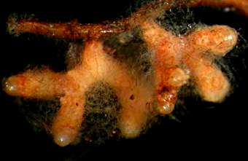
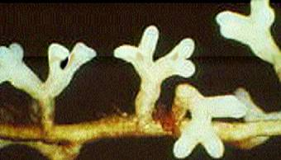
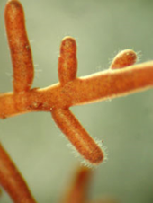
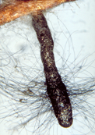


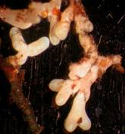
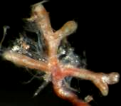



















Most plants do not have roots, but have ‘mycorrhizas’ the result of a fungus that colonises a root – a type of mutually beneficial symbiosis

Slide 35

What are mycorrhizas?
Classic definition:
a mutualistic association between plant roots and soil fungi
Mutualism based on the transfer of soil-derived nutrients to the plant from the fungus and the reciprocal transfer of photosynthate
Over 90% of all land plants so far examined form associations with mycorrhizal fungi

Slide 36






Arbuscular mycorrhizal (AM) fungi
Arbuscules
Hyphae
Arbuscules
Hyphae

Slide 37



Ectomycorrhizal (ECM) fungi
fruit body (sporocarp)
EM root tip
ECM mycelial network

Slide 38



Ectomycorrhizal host plants
About 3% of land flora =
c. 8000 spp in 100 genera
Predominantly woody perennial plants including boreal and north temperate forests and dipterocarps in SE Asia.

Slide 39


Dwarf Willow
2-3 cm high
Shorea
100 m high
Both fuelled by the activity of tiny ectomycorrhizal root tips

Slide 40


Like many fungi, mycorrhizal fungi produce fine filaments called hyphae, that forms a mycelium – the collective name for a web of hyphae
1 teaspoon of soil =
1 gram =
10-100 metres of fungal hyphae!

Slide 41


Plants colonised by mycorrhizal fungi usually grow more – why?
Without mycorrhizas
With mycorrhizas
research by Perez-Moreno and Read

Slide 42


Evidence that mycorrhizal fungal hyphae forages for nutrients beyond the reach of plant roots
37µm mesh 0.45µm mesh
control NM
2 species of AMF
Distance from root (mm)
The concentration of inorganic phosphorus in soil is reduced when mycorrhizal fungal hyphae has access to it.
The fungi are acquiring nutrients and likely transferring some to the host plant
But different species of fungi have different effects (Joner et al 1995)

Slide 43


Challenging the dogma of inorganic nutrient use by plants
Root uptake of inorganic nutrients in solution
Organic forms of nutrients
(chemically, very variable)
Inorganic (mineral) forms of nutrients
(chemically, very homogeneous)
Mineralisation process:
Free-living microbes & fauna produce enzymes that convert organic forms to inorganic forms
Big pool
Little pool

Slide 44

Challenging the dogma of inorganic nutrient use by plants
Some plants aided by mycorrhizal fungi have been shown to take up simple organic forms directly, or mineralise organic forms without the need for free-living organisms
Root uptake of inorganic nutrients in solution
Organic forms of nutrients
(chemically, very variable)
Inorganic (mineral) forms of nutrients
(chemically, very homogeneous)
Mineralisation process:
Free-living microbes & fauna produce enzymes that convert organic forms to inorganic forms
Big pool
Little pool

Slide 45




Direct uptake of simple organic nitrogen forms
Analysis of leaves to measure amount of ¹³C and ¹⁵N
A constant ¹³C:¹⁵N ratio equivalent to that of the substrate shows the molecule remained intact when taken up by plant roots/mycorrhiza
But absolute amounts taken up can vary
¹³C
¹⁵N
The chemical structure of the amino acid glycine
It can be synthesised so it is ‘dual labelled’ i.e. it contains carbon-13 and nitrogen-15
The ratio of ¹³C:¹⁵N is constant
Dual-labelled glycine injected into soil

Slide 46

Transfer of an organic nitrogen molecule (an amino acid) by an ectomycorrhizal fungus (Paxillus involutus) colonising a Scots pine seedling.
What controls nutrient movement in complex networks?

Slide 47

The N cycle in many natural or ‘semi-natural’ ecosystems is highly conservative and closed
Highly Labile
Organic
Nitrogen
Little nitrification
(conversion of NH4 to NO3)
Recalcitrant
Little ammonification (conversion of organic N to NH4)

Slide 48

Many crop plants evolved to associate with mycorrhizal fungi……
Major cereal crops are all grasses in the Family Poaceae)
The ‘wild types’ are highly dependent on mycorrhizal fungi
There is evidence that thousands of years of breeding has reduced (but not eliminated) this dependency

Slide 49


Nitrogen fixation – another wonder of evolution!
Plants that fix N₂ from the atmosphere are in the family Fabaceae (was called leguminosae)
Very large and diverse family (~20000 species, ~730 genera) – includes trees, shrubs and herbaceous perennials and annuals.
These plants associate with specialised bacteria that have the capacity to fix N₂ from the atmosphere

Slide 50

Many nitrogen-fixing plants are VITAL for human health and nutrition
These are all plants in the Family Fabaceae
They include beans and lentils
The bacteria form distinct ‘nodules’ on roots
They also form mycorrhizas but mycorrhizal and rhizobial symbioses are distinct and separate

Slide 51

Nitrogen fixation from the atmosphere is undertaken by mutualistic bacteria that colonise roots of plants in the Fabaceae
N₂ + 8H⁺ + 8e⁻ → 2NH₃ + H₂
Nodule
Catalysed by the enzyme nitrogenase
Alpha-proteobacteria:
including Rhizobium, Mesorhizobium, Bradyrhizobium, Aminobacter
e.g. Rhizobium leguminosum (left), R. alamii, R. fabae, R. giardinii
Beta-proteobacteria
including Burkholderia,Cupriavidus
e.g. Burkholderia dolosa, B. sabiae, B. tuberum
Bacteria

Slide 52
‘Natural’ or biological nitrogen fixation is globally important!
Type of fixation | N₂ fixed (10¹² g per year, or 10⁶ metric tons per year)
Non-biological
Industrial | about 50
Combustion | about 20
Lightning | about 10
Total | about 80
Biological
Agricultural land | about 90
Forest and non-agricultural land | about 50
Sea | about 35
Total | about 175
Data from various sources, compiled by DF Bezdicek & AC Kennedy, in Microorganisms in Action (eds. JM Lynch & JE Hobbie). Blackwell Scientific Publications 1998.

Slide 53

But some (~15% of world total) plants have evolved not to associate with microorganisms (either mycorrhizal fungi or bacteria)
Some important non-mycorrhizal and non-N fixing species below to the Family Brassicaceae
Cabbages, sprouts, spinach…
How can these plants compete against plants that have highly evolved root-fungal or root-bacterial symbioses?

Slide 54
Key messages
Plants need to acquire resources, notably nutrients, water and energy
Their interactions with myriad soil microorganisms are crucial to help them acquire resources from both soil and atmosphere
Can we harness “the power of evolution” and develop crop varieties or cropping systems that exploit natural mechanisms?

Slide 55

Publication of the week!
New Phytologist (2019) 222: 543–555
doi: 10.1111/nph.15570
What is a “meta analysis”?

Slide 56


Can we start using mycorrhizal fungi to increase crop production?
Field trials

Slide 57




What is mycorrhizal fungal inoculum?
Commercial inocula:
No accreditation!
Inocula often mixed with carrying agents
Vague descriptions about what the inocula is and how it was produced
Some companies have more rigorous standards
Scientific trials:
Inocula usually obtained from specific organisms from reputable repositories
For AM fungi, the main species used is Funneliformis mosseae (synonym Glomus mosseae)
Trials usually conducted following established experimental designs

Slide 58
Why are mycorrhizal inoculation products not widely used?
Effectiveness often ‘context dependent’
Not as good as fertilisers in supplying nutrients to plants!
Some crop varieties (variety = genotype, often ‘bred’ by humans for specific traits) do not respond well to mycorrhizal inoculation
Expensive
Lack of technical know-how

Slide 59


Slide 60
Aims of the paper
Test whether adding AM fungal inoculum has a consistent effect on grain yield
By doing a meta-analysis – a plethora of other information can be considered in the analyses:
Thus they can test for relationships with a range of “moderator variables”, such as experiment type (lab or field), fertiliser addition, crop type, photosynthetic strategy etc etc
The key metric produced is called “effect size”
The effect size is simply a metric derived from the difference between control and treated crops. It can be either + or -, and can be statistically tested to differ from zero.

Slide 61

In MOST trials, arbuscular mycorrhizal fungi positively affected grain yield

Slide 62


Slide 63
Questions for you to think about here and now and afterwards:
How do you explain the variation in yield across the study?
What circumstances or conditions could you envisage mycorrhizal fungal inocula being most effective?
The study focused on grain yields – is this the only thing that should be considered?

Slide 64
Example short answer question:
1. You are a consultant advising farmers on ways to reduce greenhouse gas emissions from their croplands: what advice would you give to reduce nitrous oxide (N2O) emissions and why?
Nitrous oxide (N2O) is a potent greenhouse gas and it is vital to reduce emissions from agricultural lands. The production of N2O is a microbial-driven process undertaken by soil bacteria. There a several factors that control the production of N2O in soils, some of which can be managed by agricultural practices. The most important control is oxygen availability. N2O is produced in soil when oxygen concentrations are low, and this usually occurs when soil pores are full of water. Therefore, ensuring fields are well-drained will help ensure soils remain aerobic, and prevent production of N2O. Other factors that increase water holding capacity of soils may also help, for example maintaining good soil structure and preventing compaction of soils.
N2O is also dependent on the availability of a suitable substrate. Nitrate (NO3) is the most important substrate because this is required for denitrification to occur. Since most fertilisers contain nitrate, the over-use of fertiliser N may stimulate N2O production when the conditions allow. Fertilisers that contain NH4 (such as many organic wastes) may also be a problem because conversion of NH4 to NO3 (nitrification) can generate N2O. Thus, efficient and modest use of all fertilisers, organic and inorganic, should be recommended.

